Slide 2
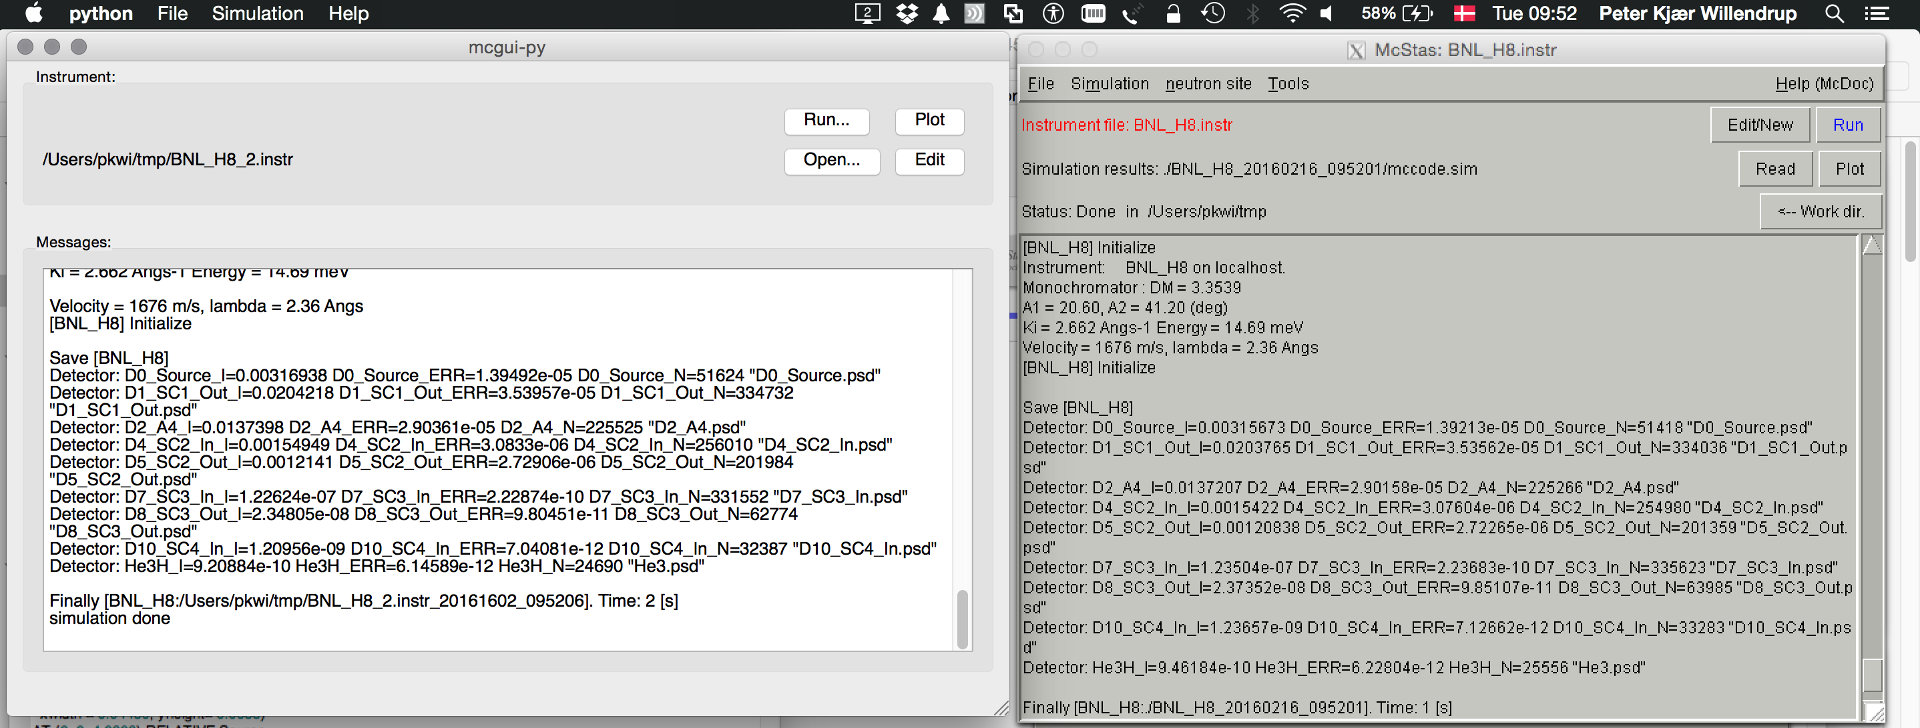
mcgui - pl vs py versions

Slide 3
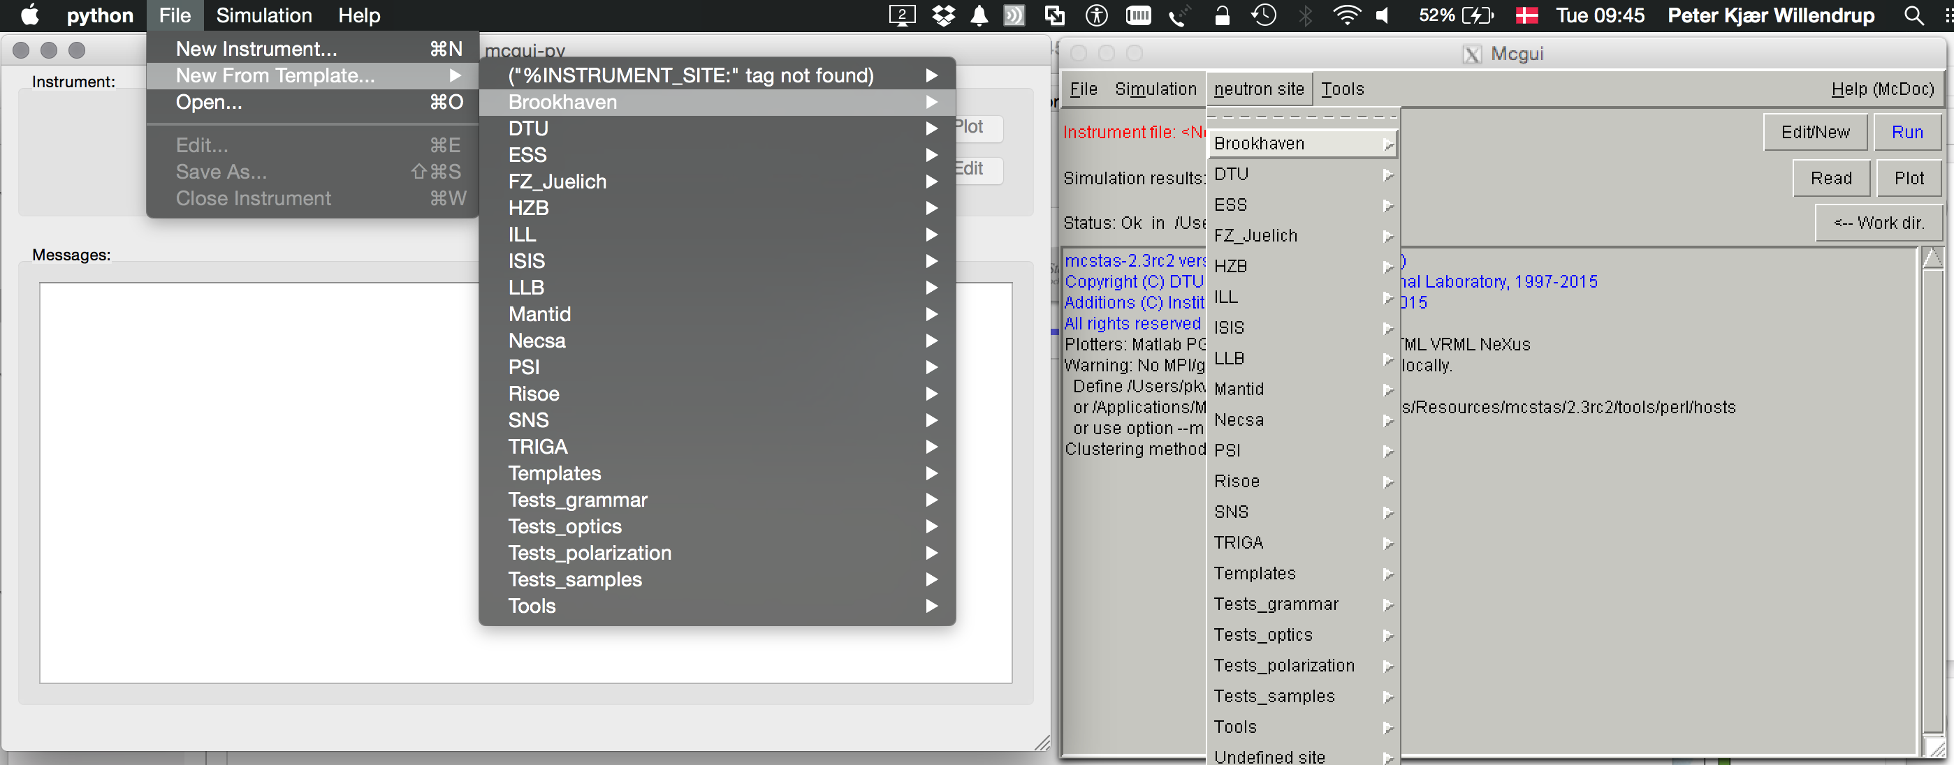
mcgui - pl vs py versions

Slide 4
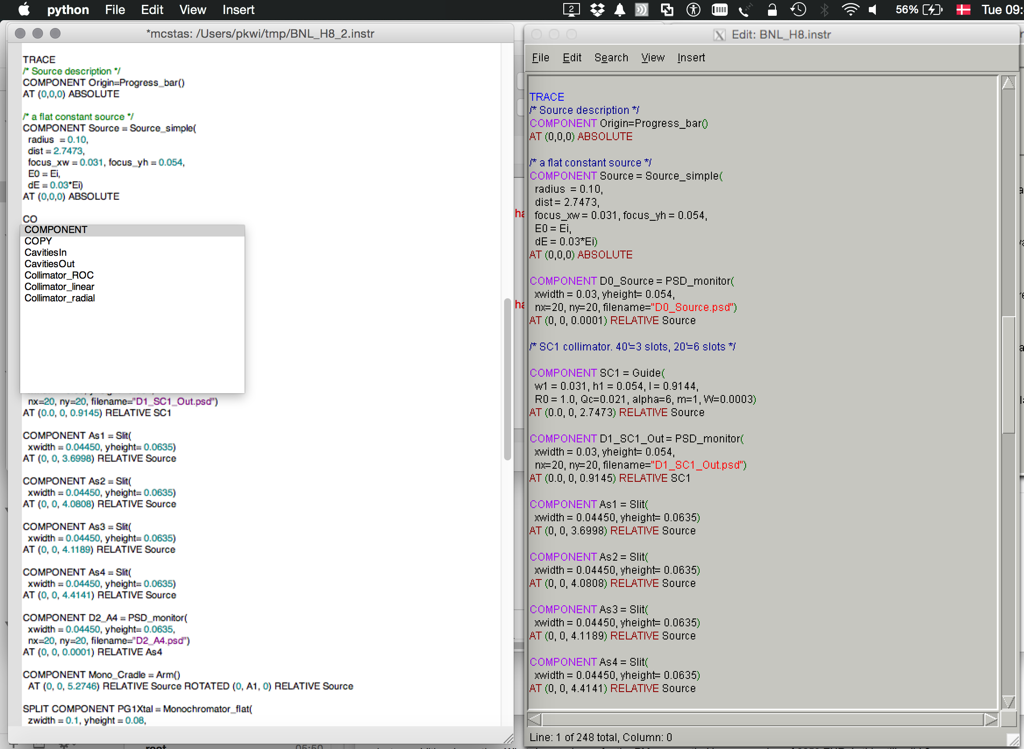
mcgui - pl vs py versions

Slide 5
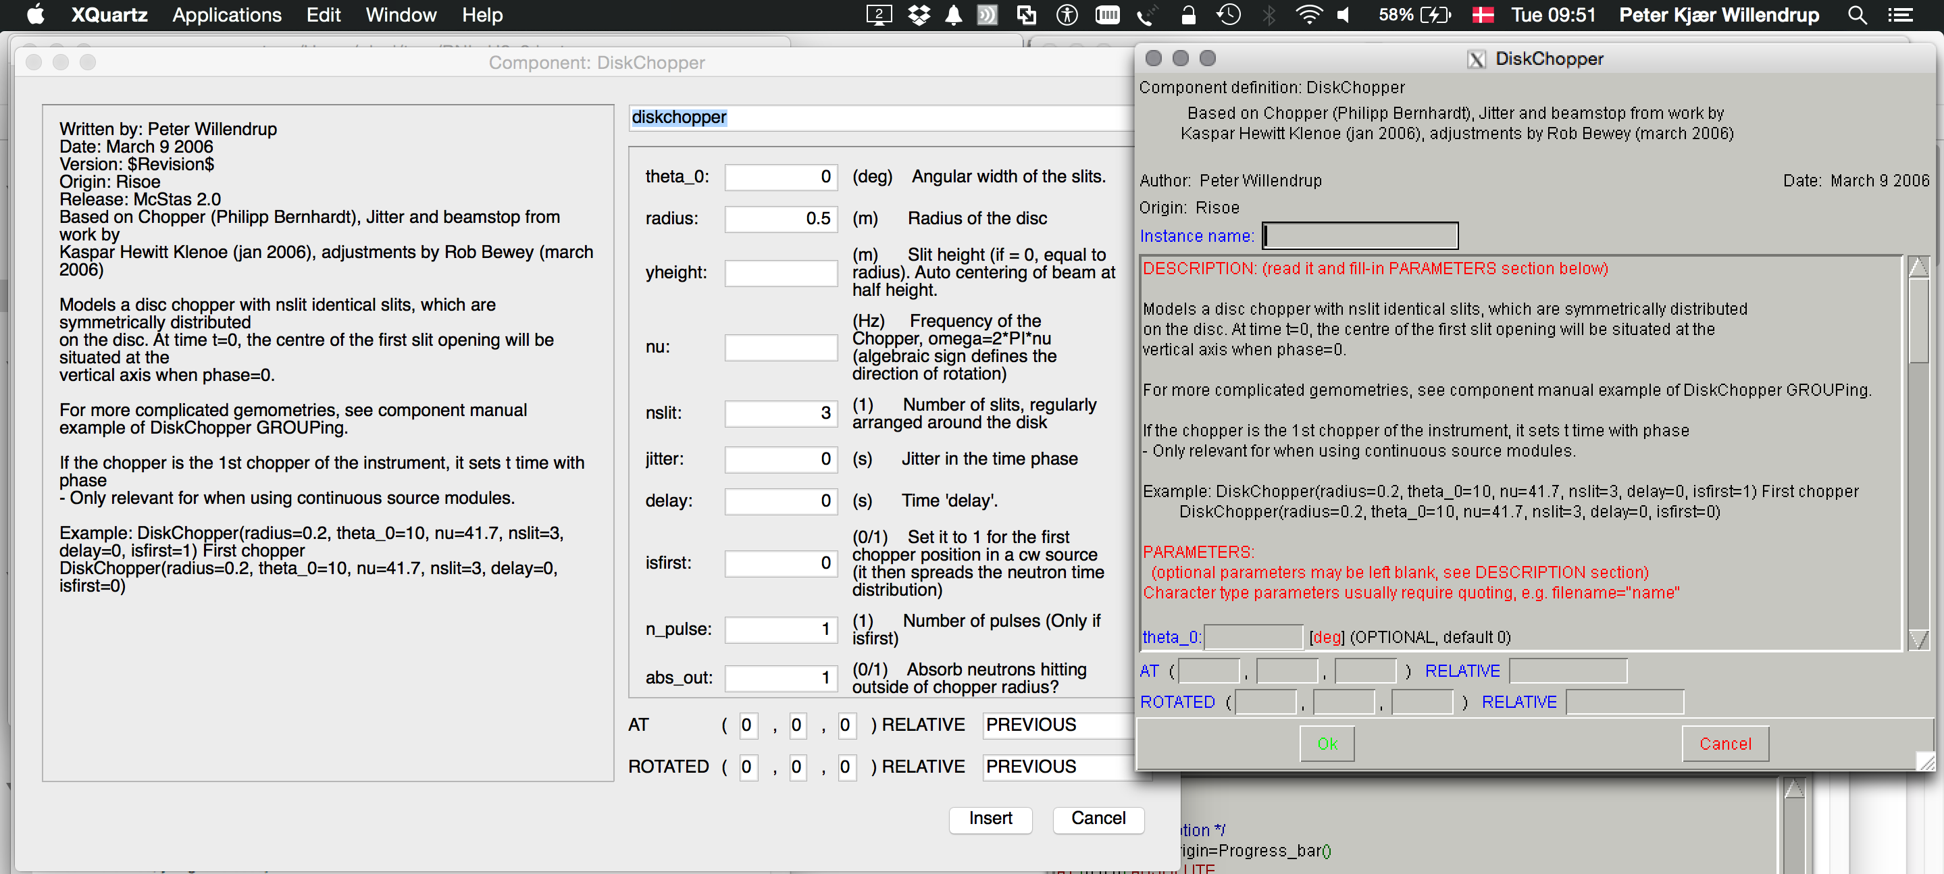
mcgui - pl vs py versions

Slide 6
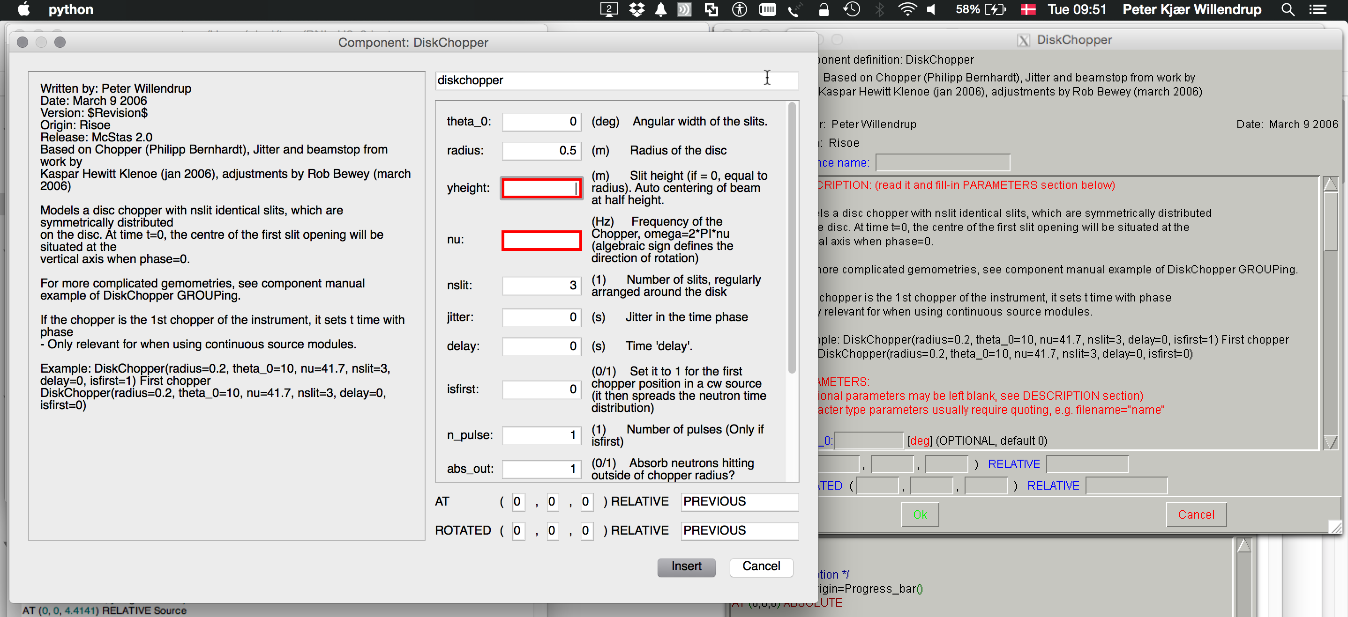
mcgui - pl vs py versions

Slide 7
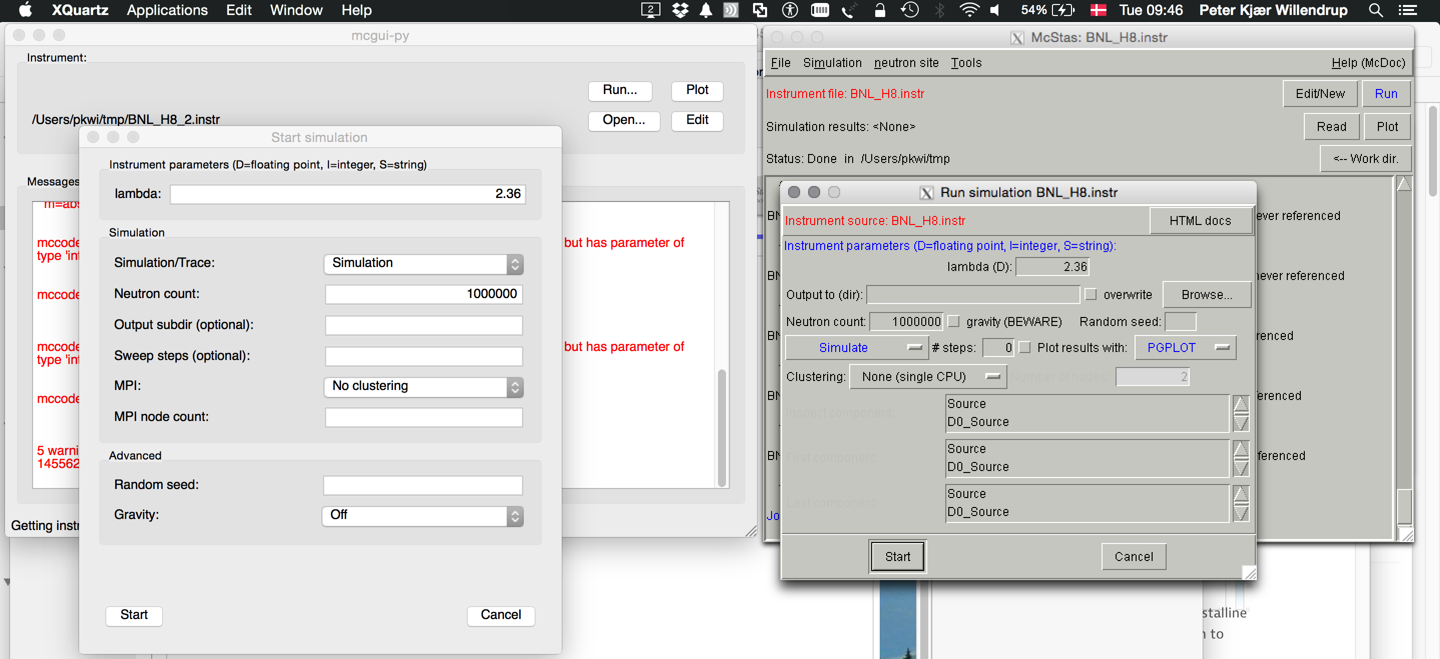
mcgui - pl vs py versions

Slide 8
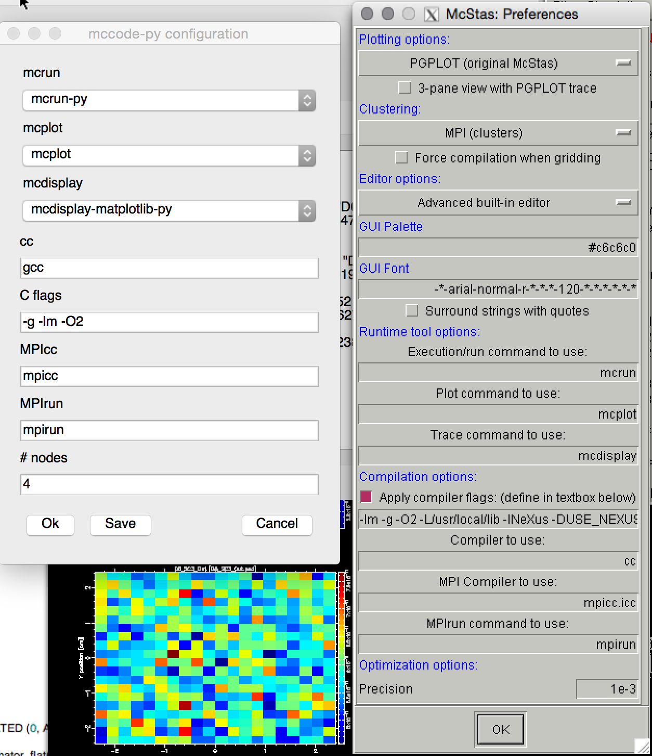
mcgui - pl vs py versions

Slide 9
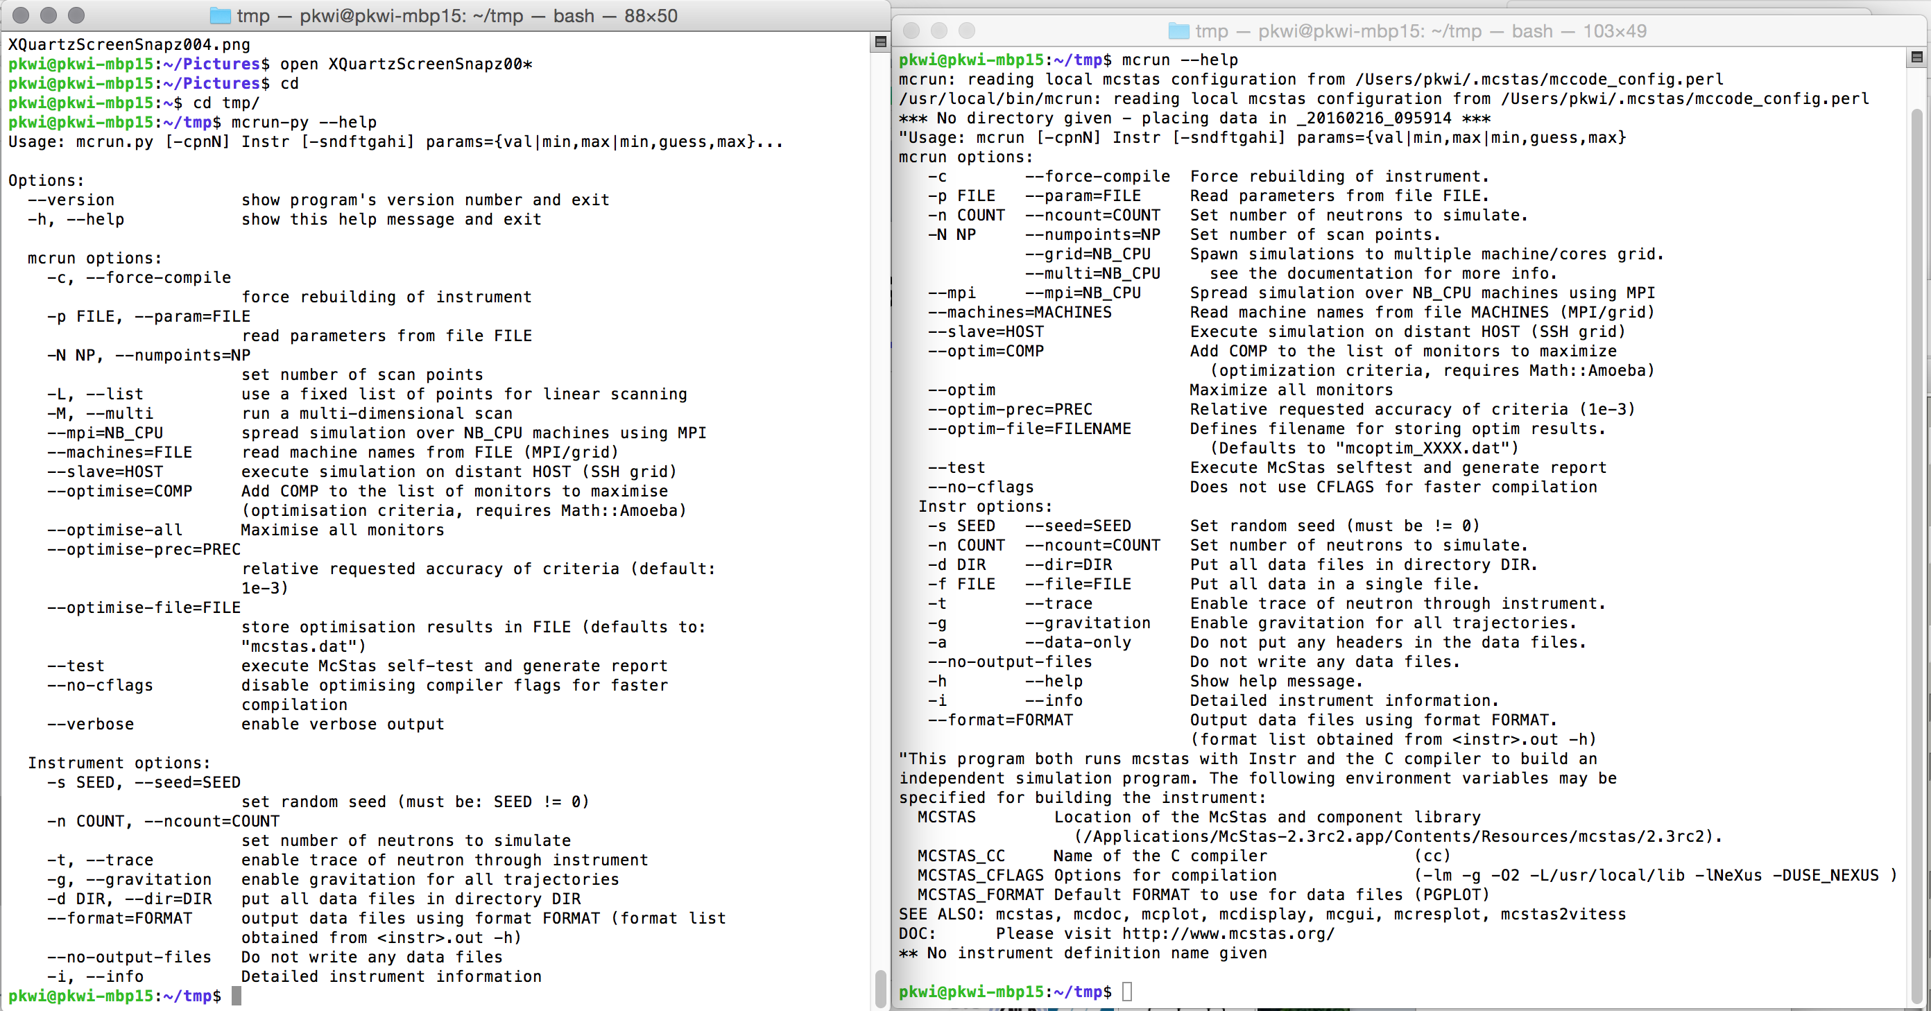
mcrun pl vs py versions

Slide 10
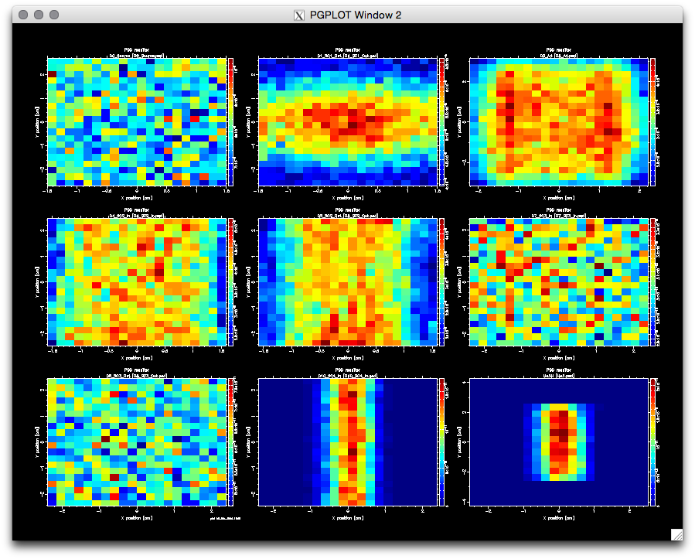
mcplot (--format=PGPLOT)

Slide 11
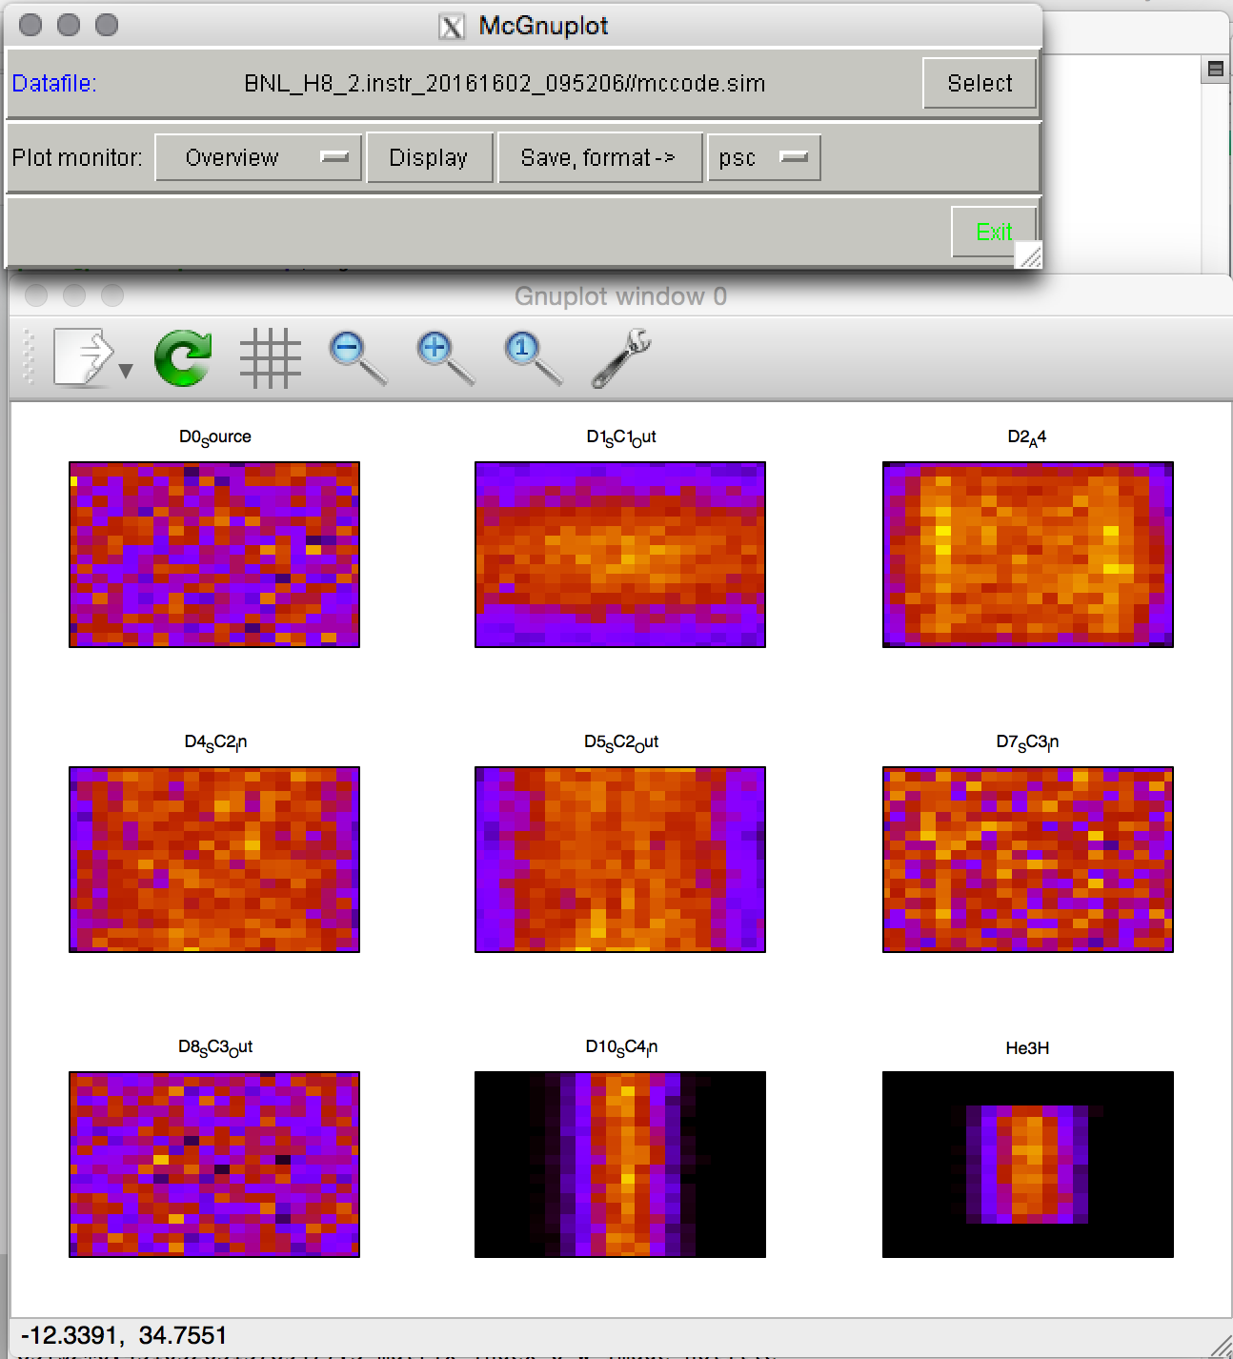
mcplot --format=Gnuplot

Slide 12
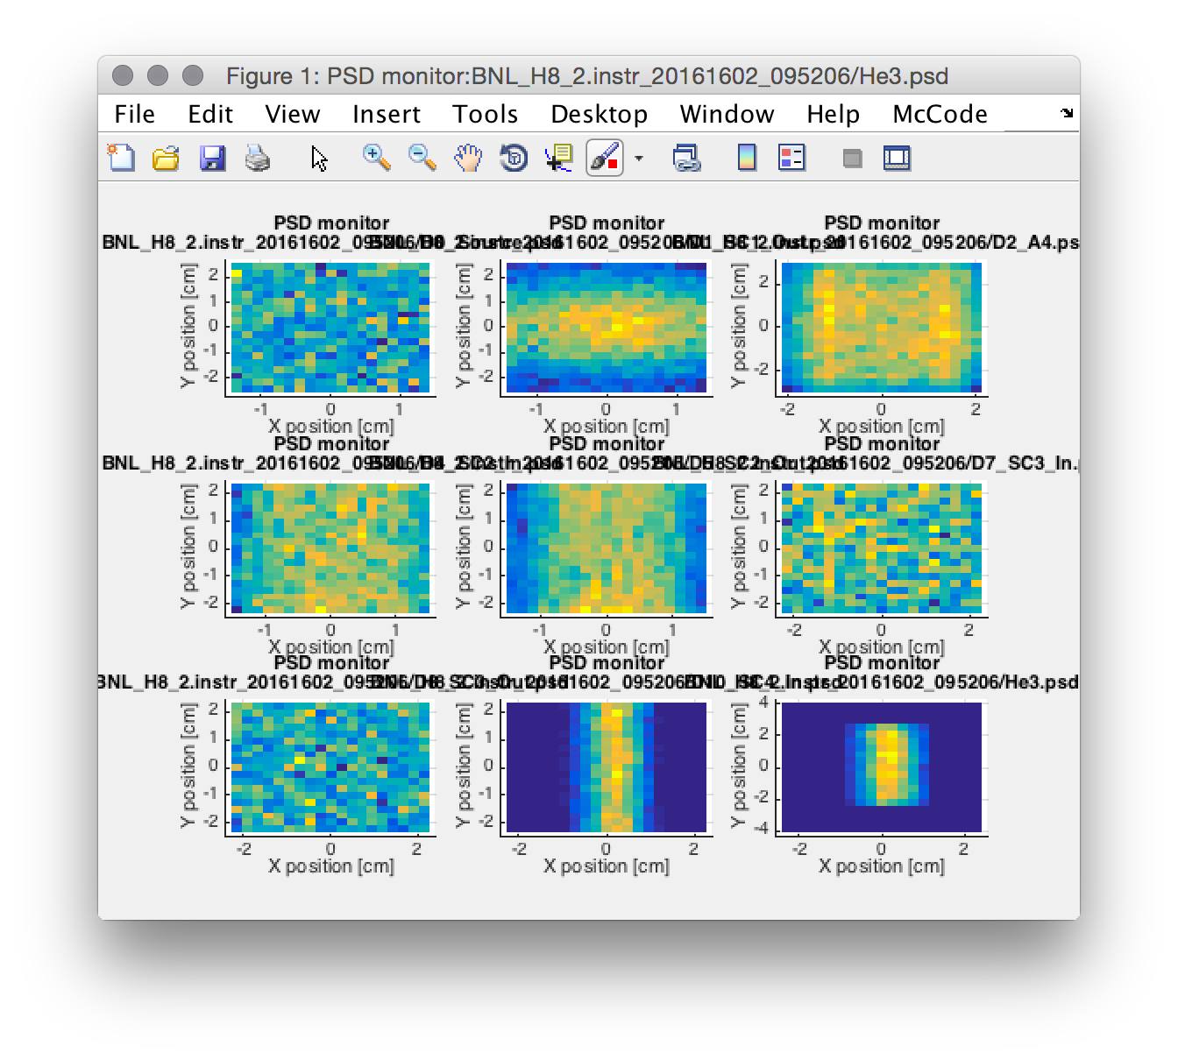
mcplot --format=Matlab

Slide 13
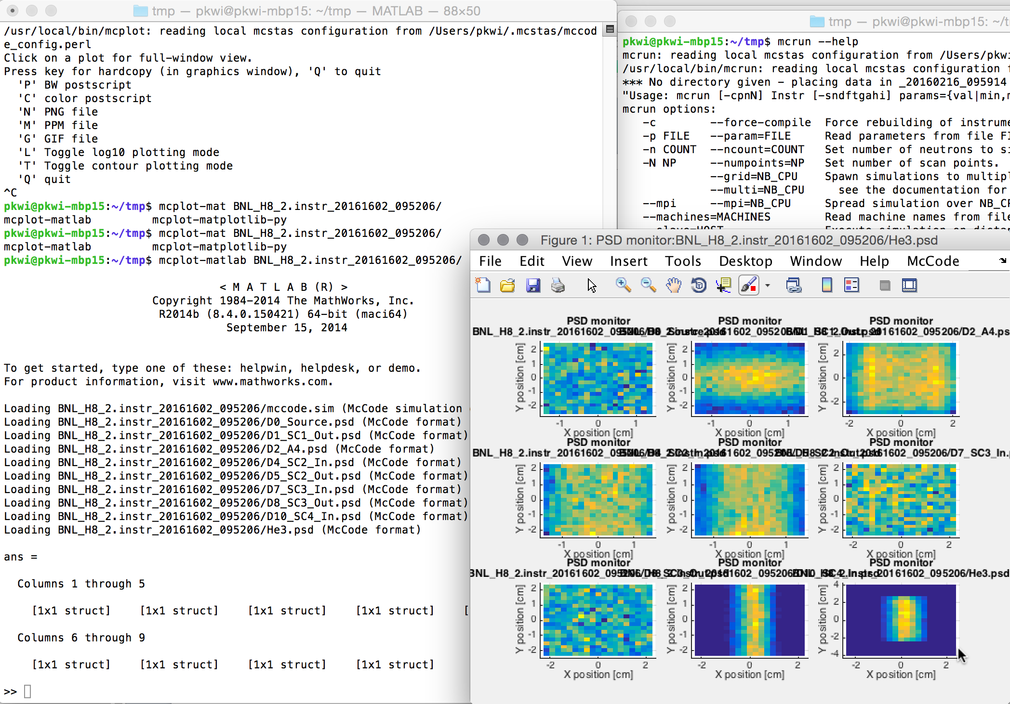
mcplot-matlab

Slide 14
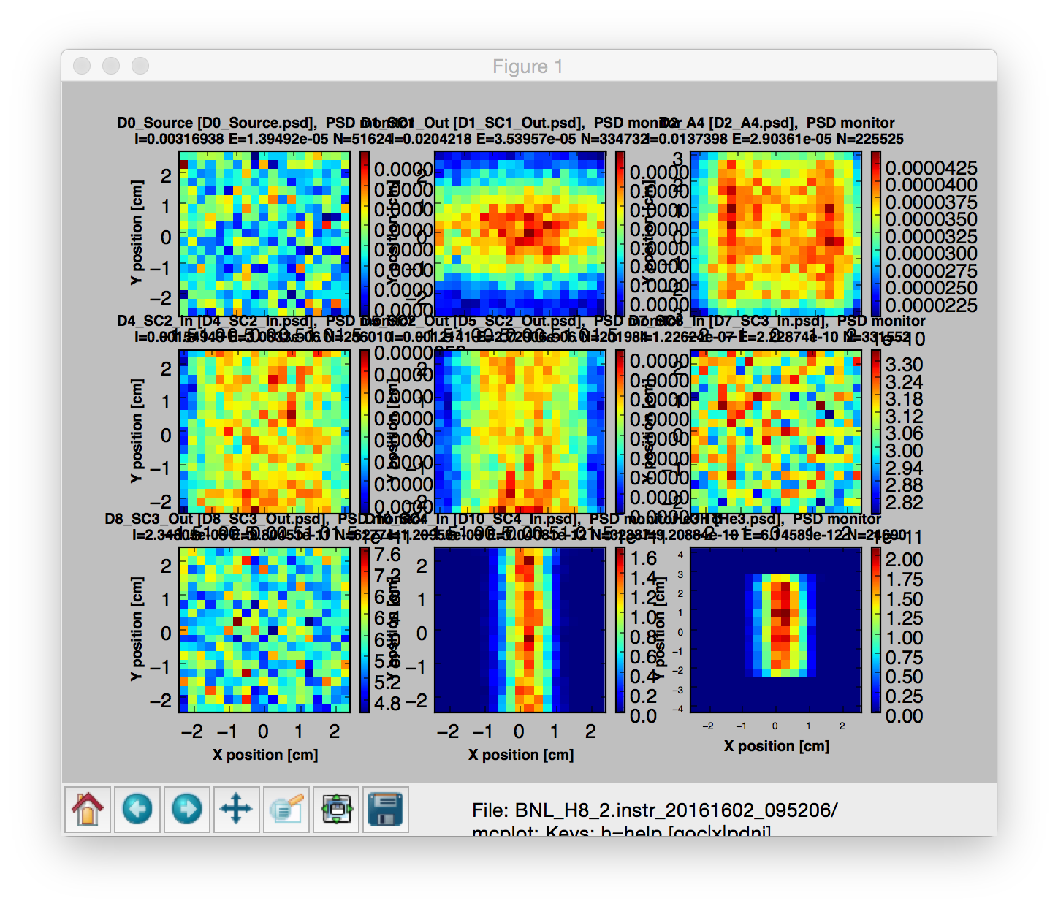
mcplot-matplotlib-py

Slide 15
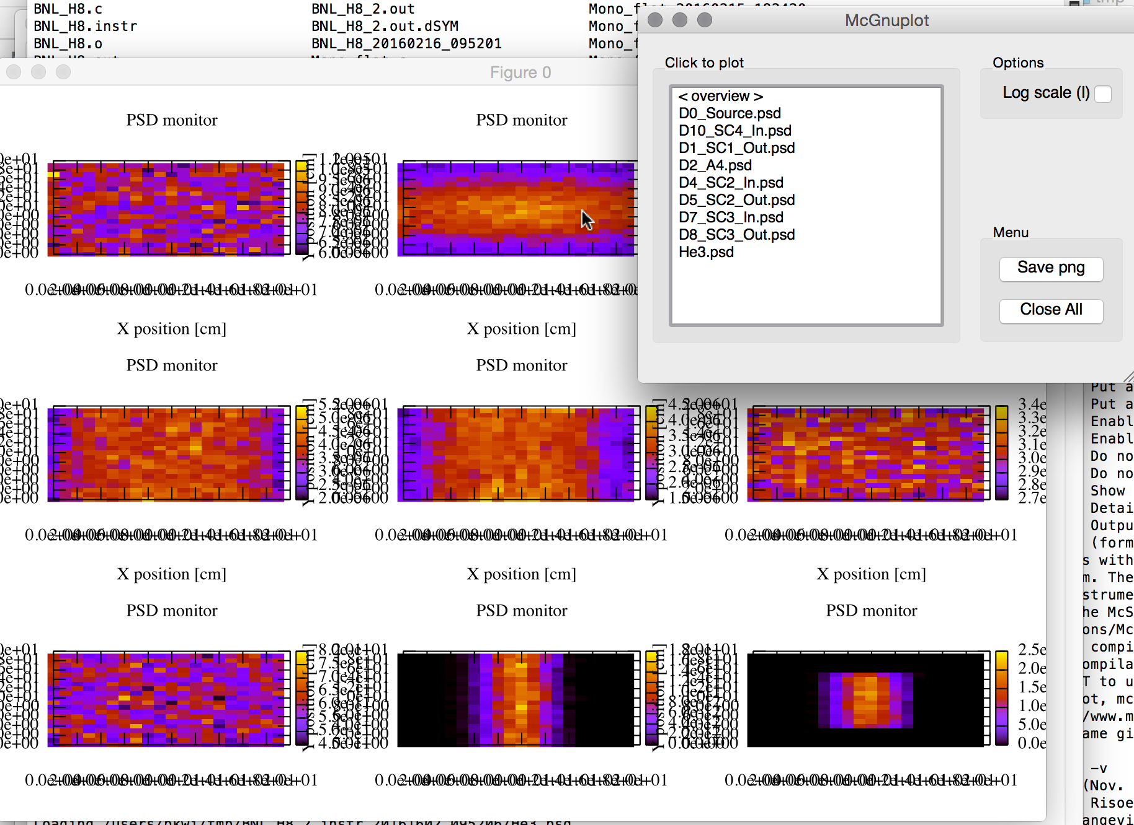
mcplot-gnuplot-py

Slide 16
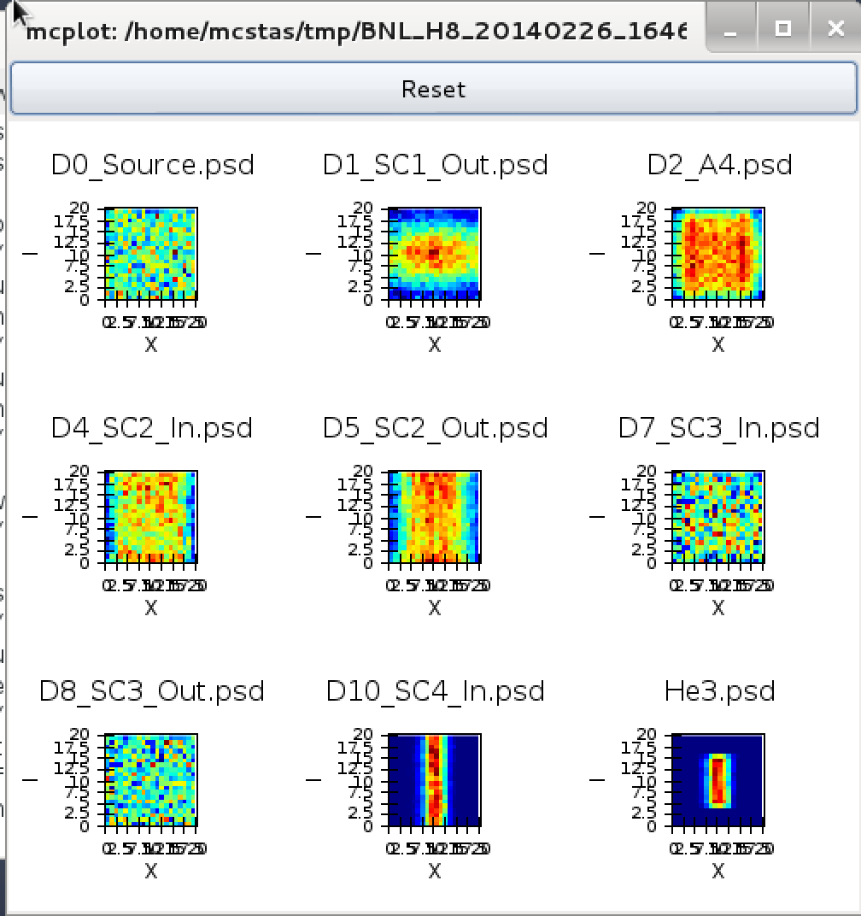
mcplot-chaco-py

Slide 17
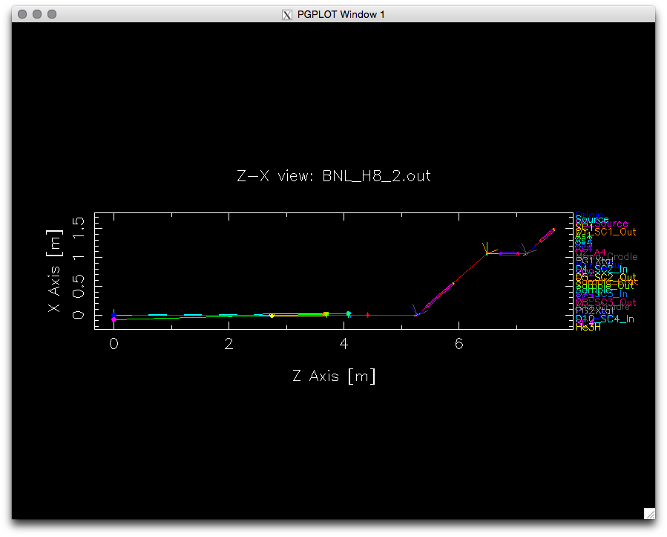
mcdisplay

Slide 18
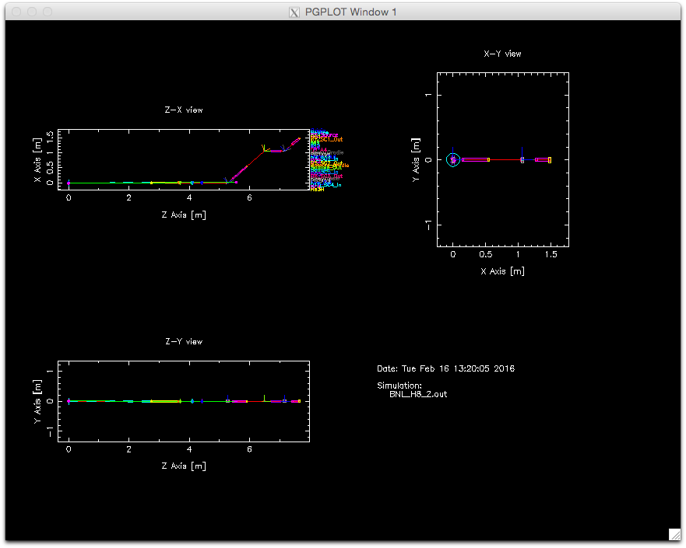
mcdisplay -m

Slide 19
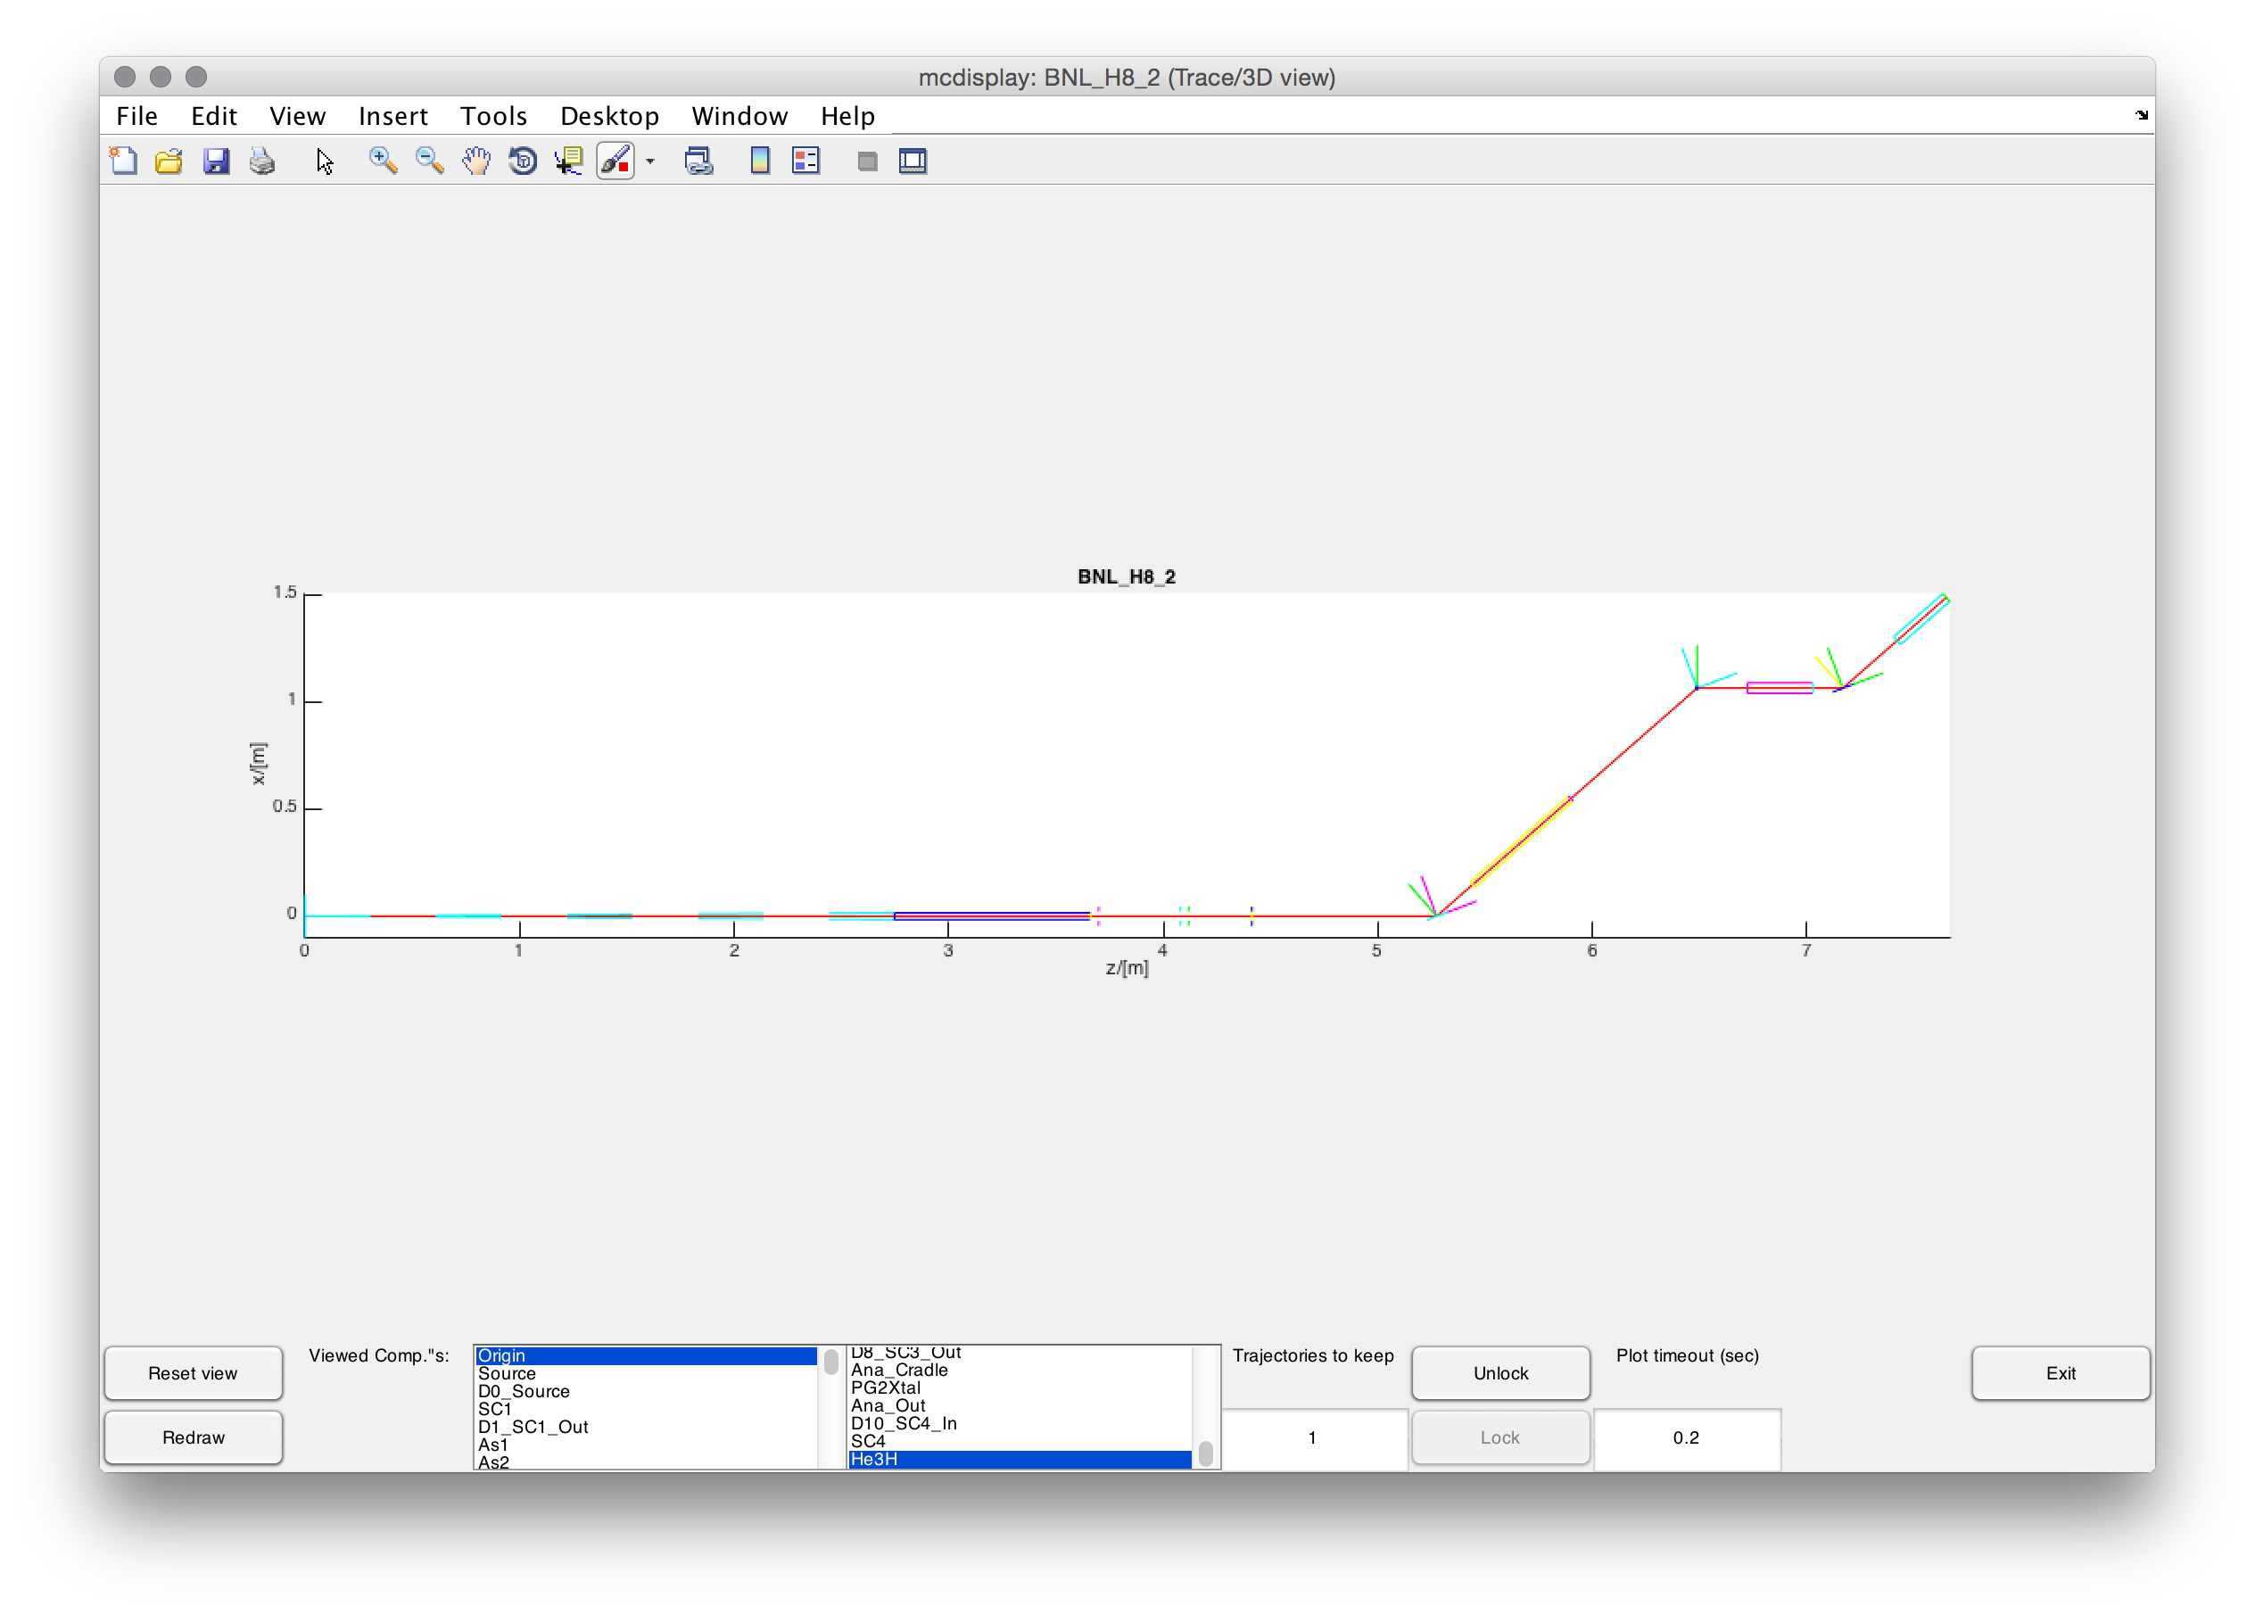
mcdisplay --format=Matlab

Slide 20
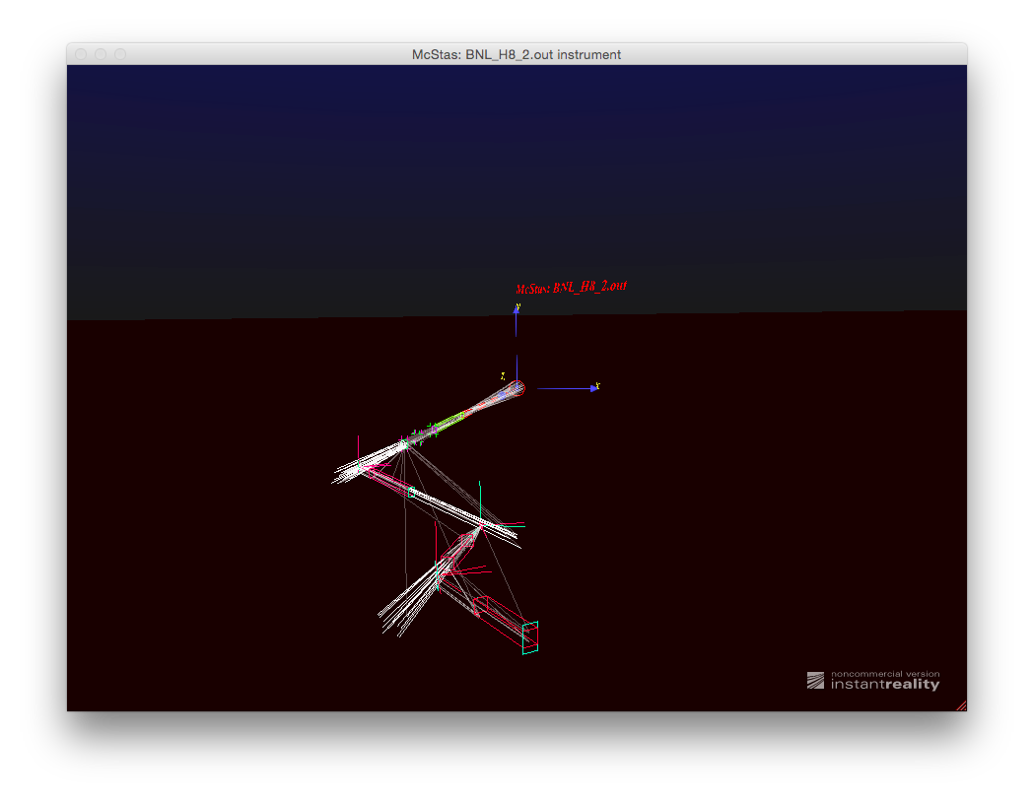
mcdisplay --format=VRML

Slide 21
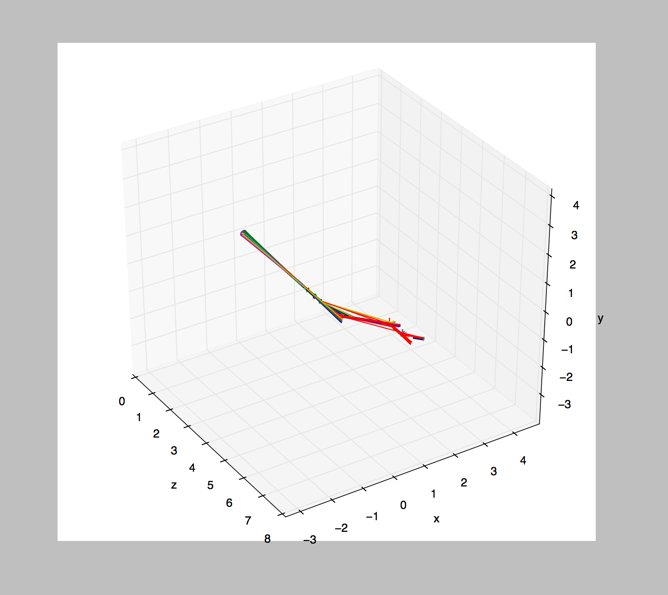
mcdisplay-matplotlib-py

Slide 22
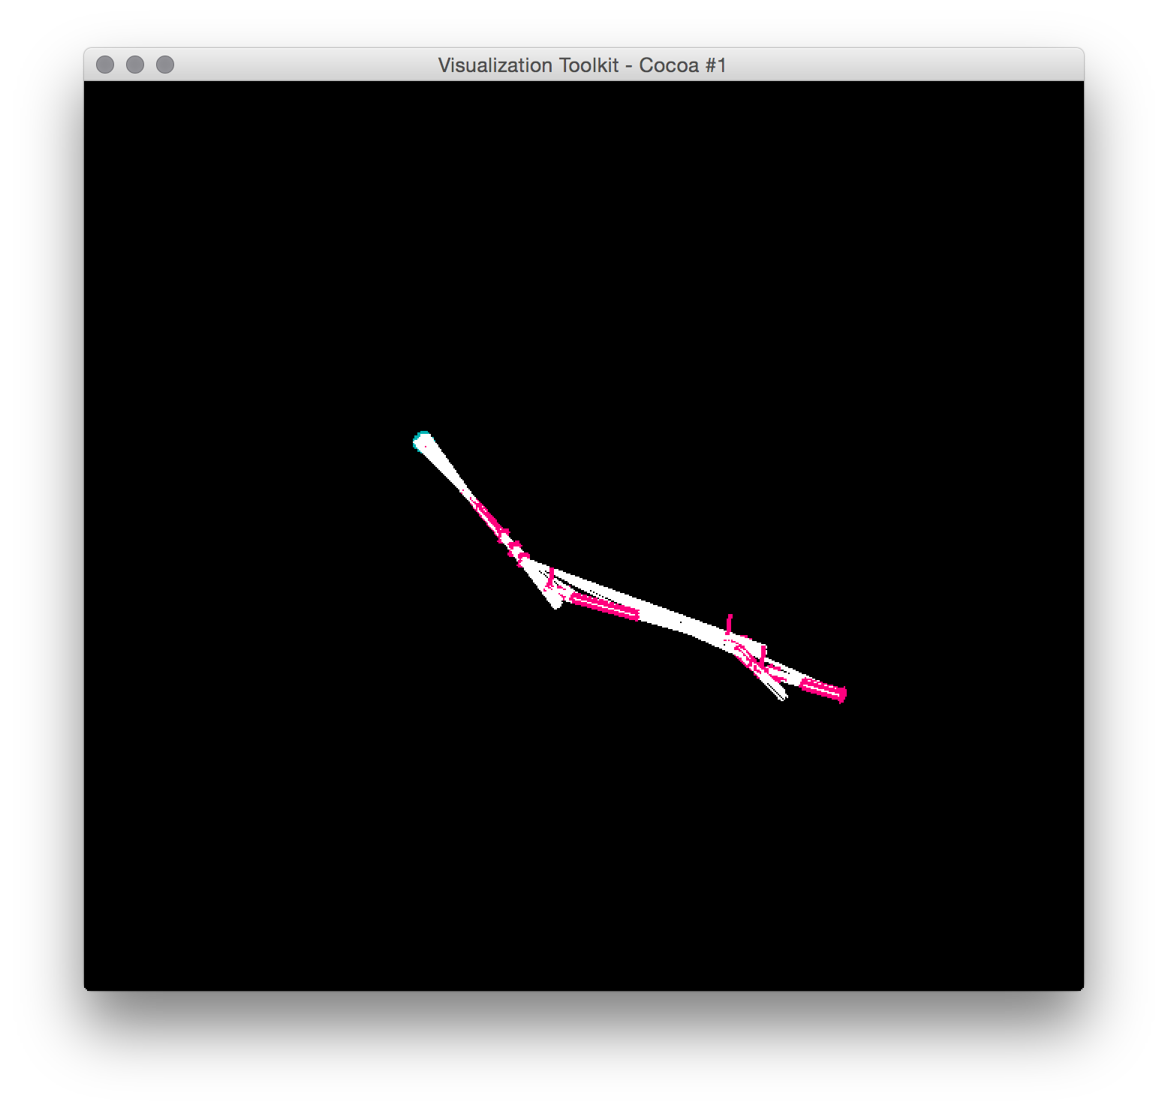
mcdisplay-vtk-py

Slide 23
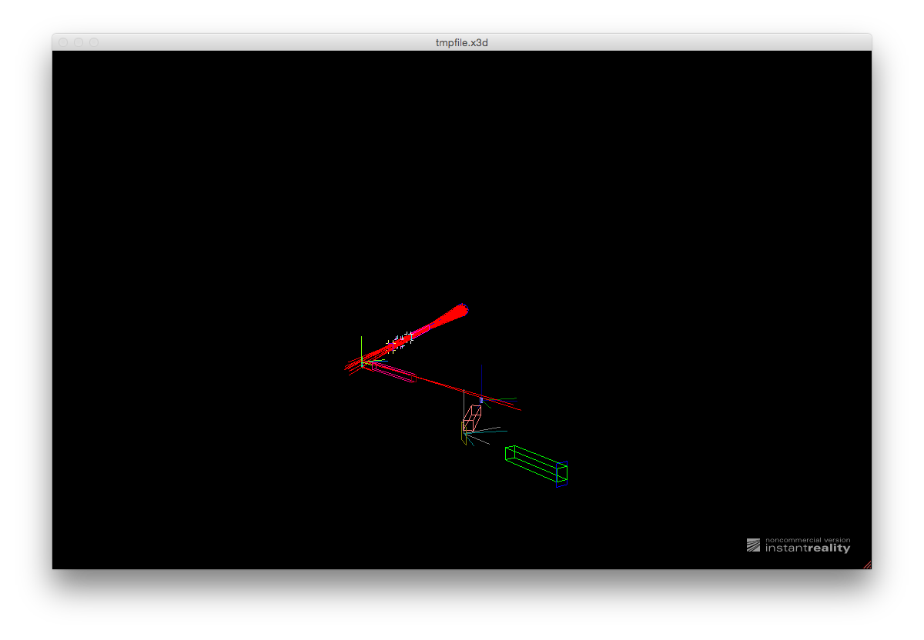
mcdisplay-x3d-py

Slide 24
mcdisplay --format=VRML

Slide 25
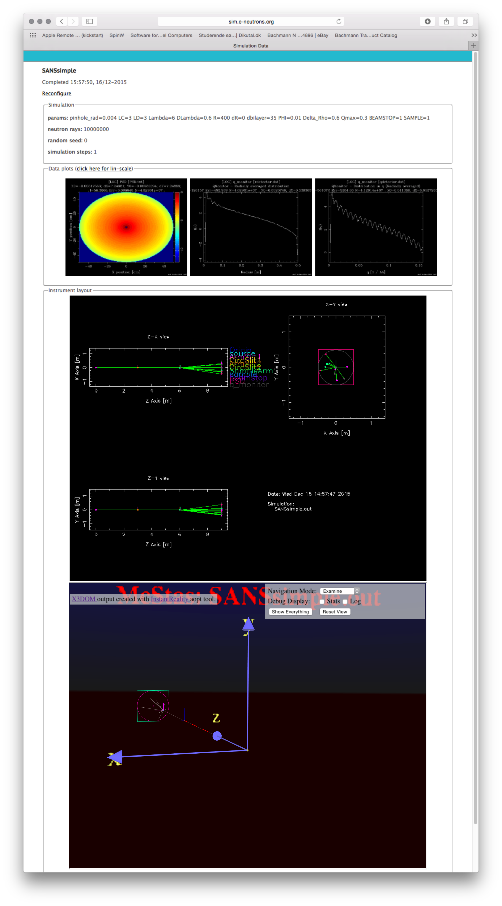
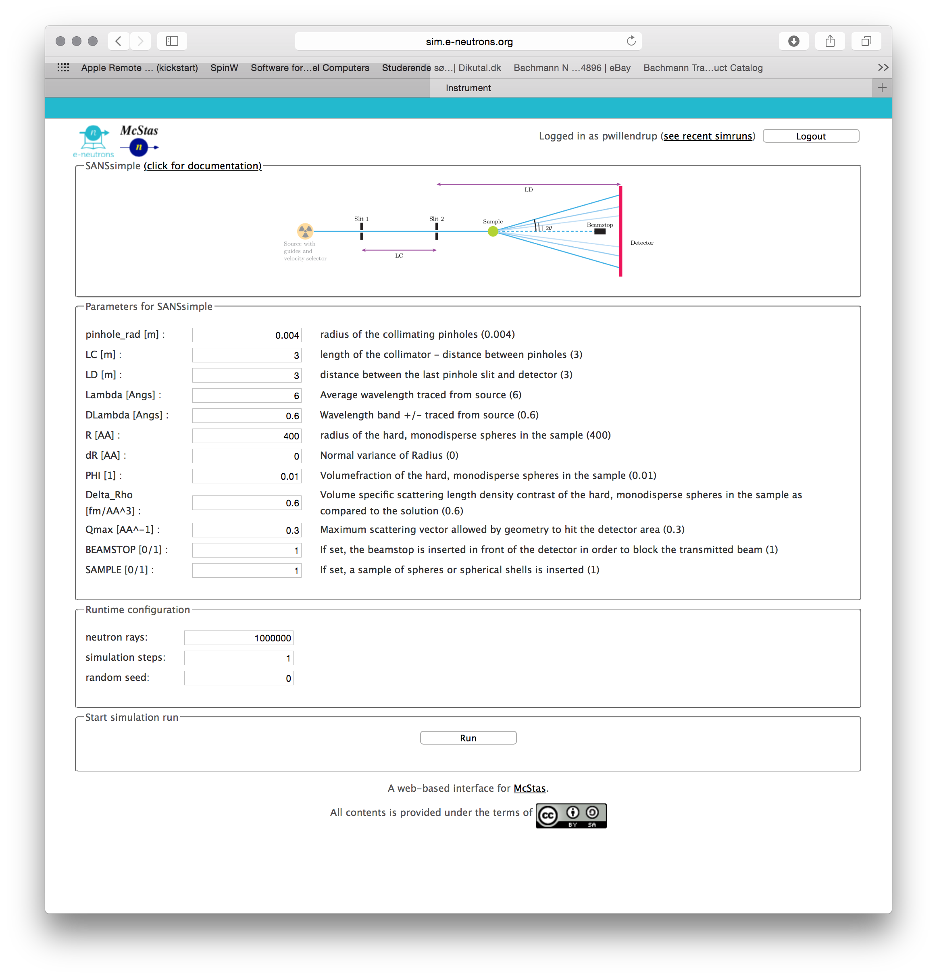
Web interface @ e-neutrons.org

Slide 26
Web interface @ e-neutrons.org
Only pre-defined instruments!!!

Slide 27
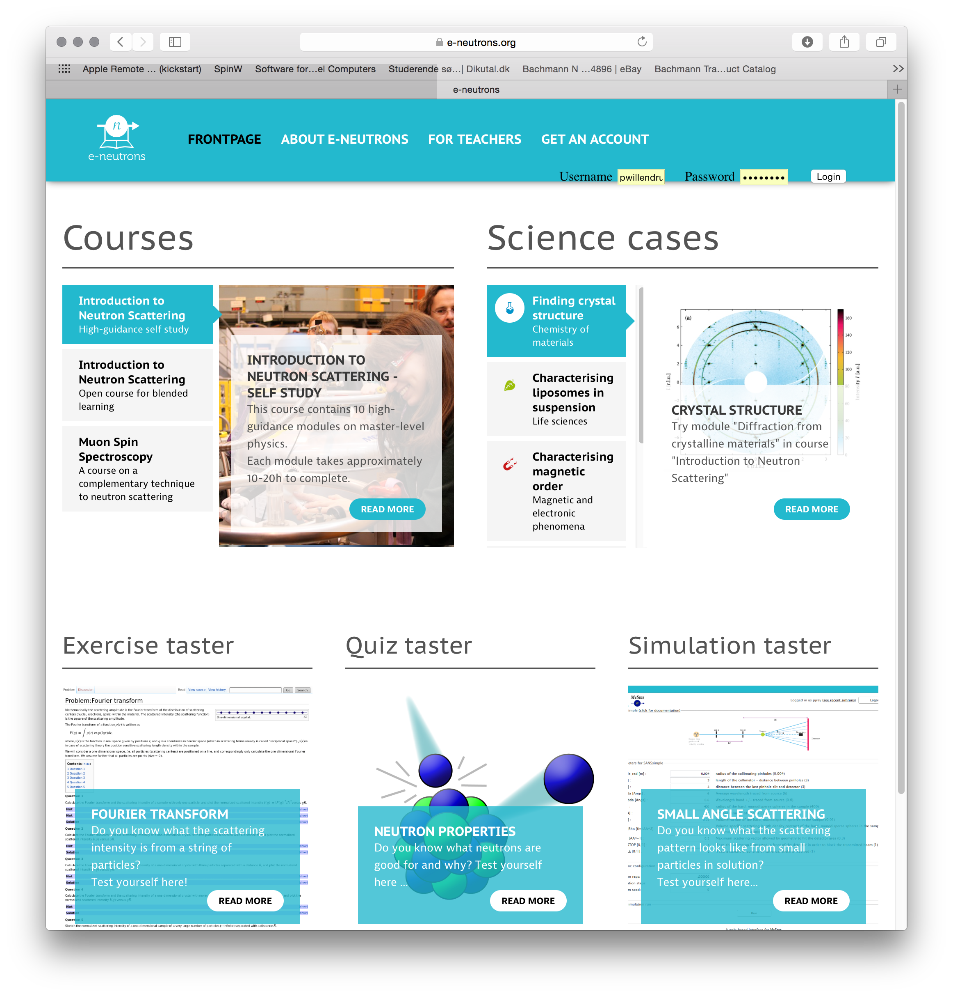
Web interface @ e-neutrons.org

Slide 28
Web interface @ e-neutrons.org
Online-course on neutron scattering available!

Slide 29
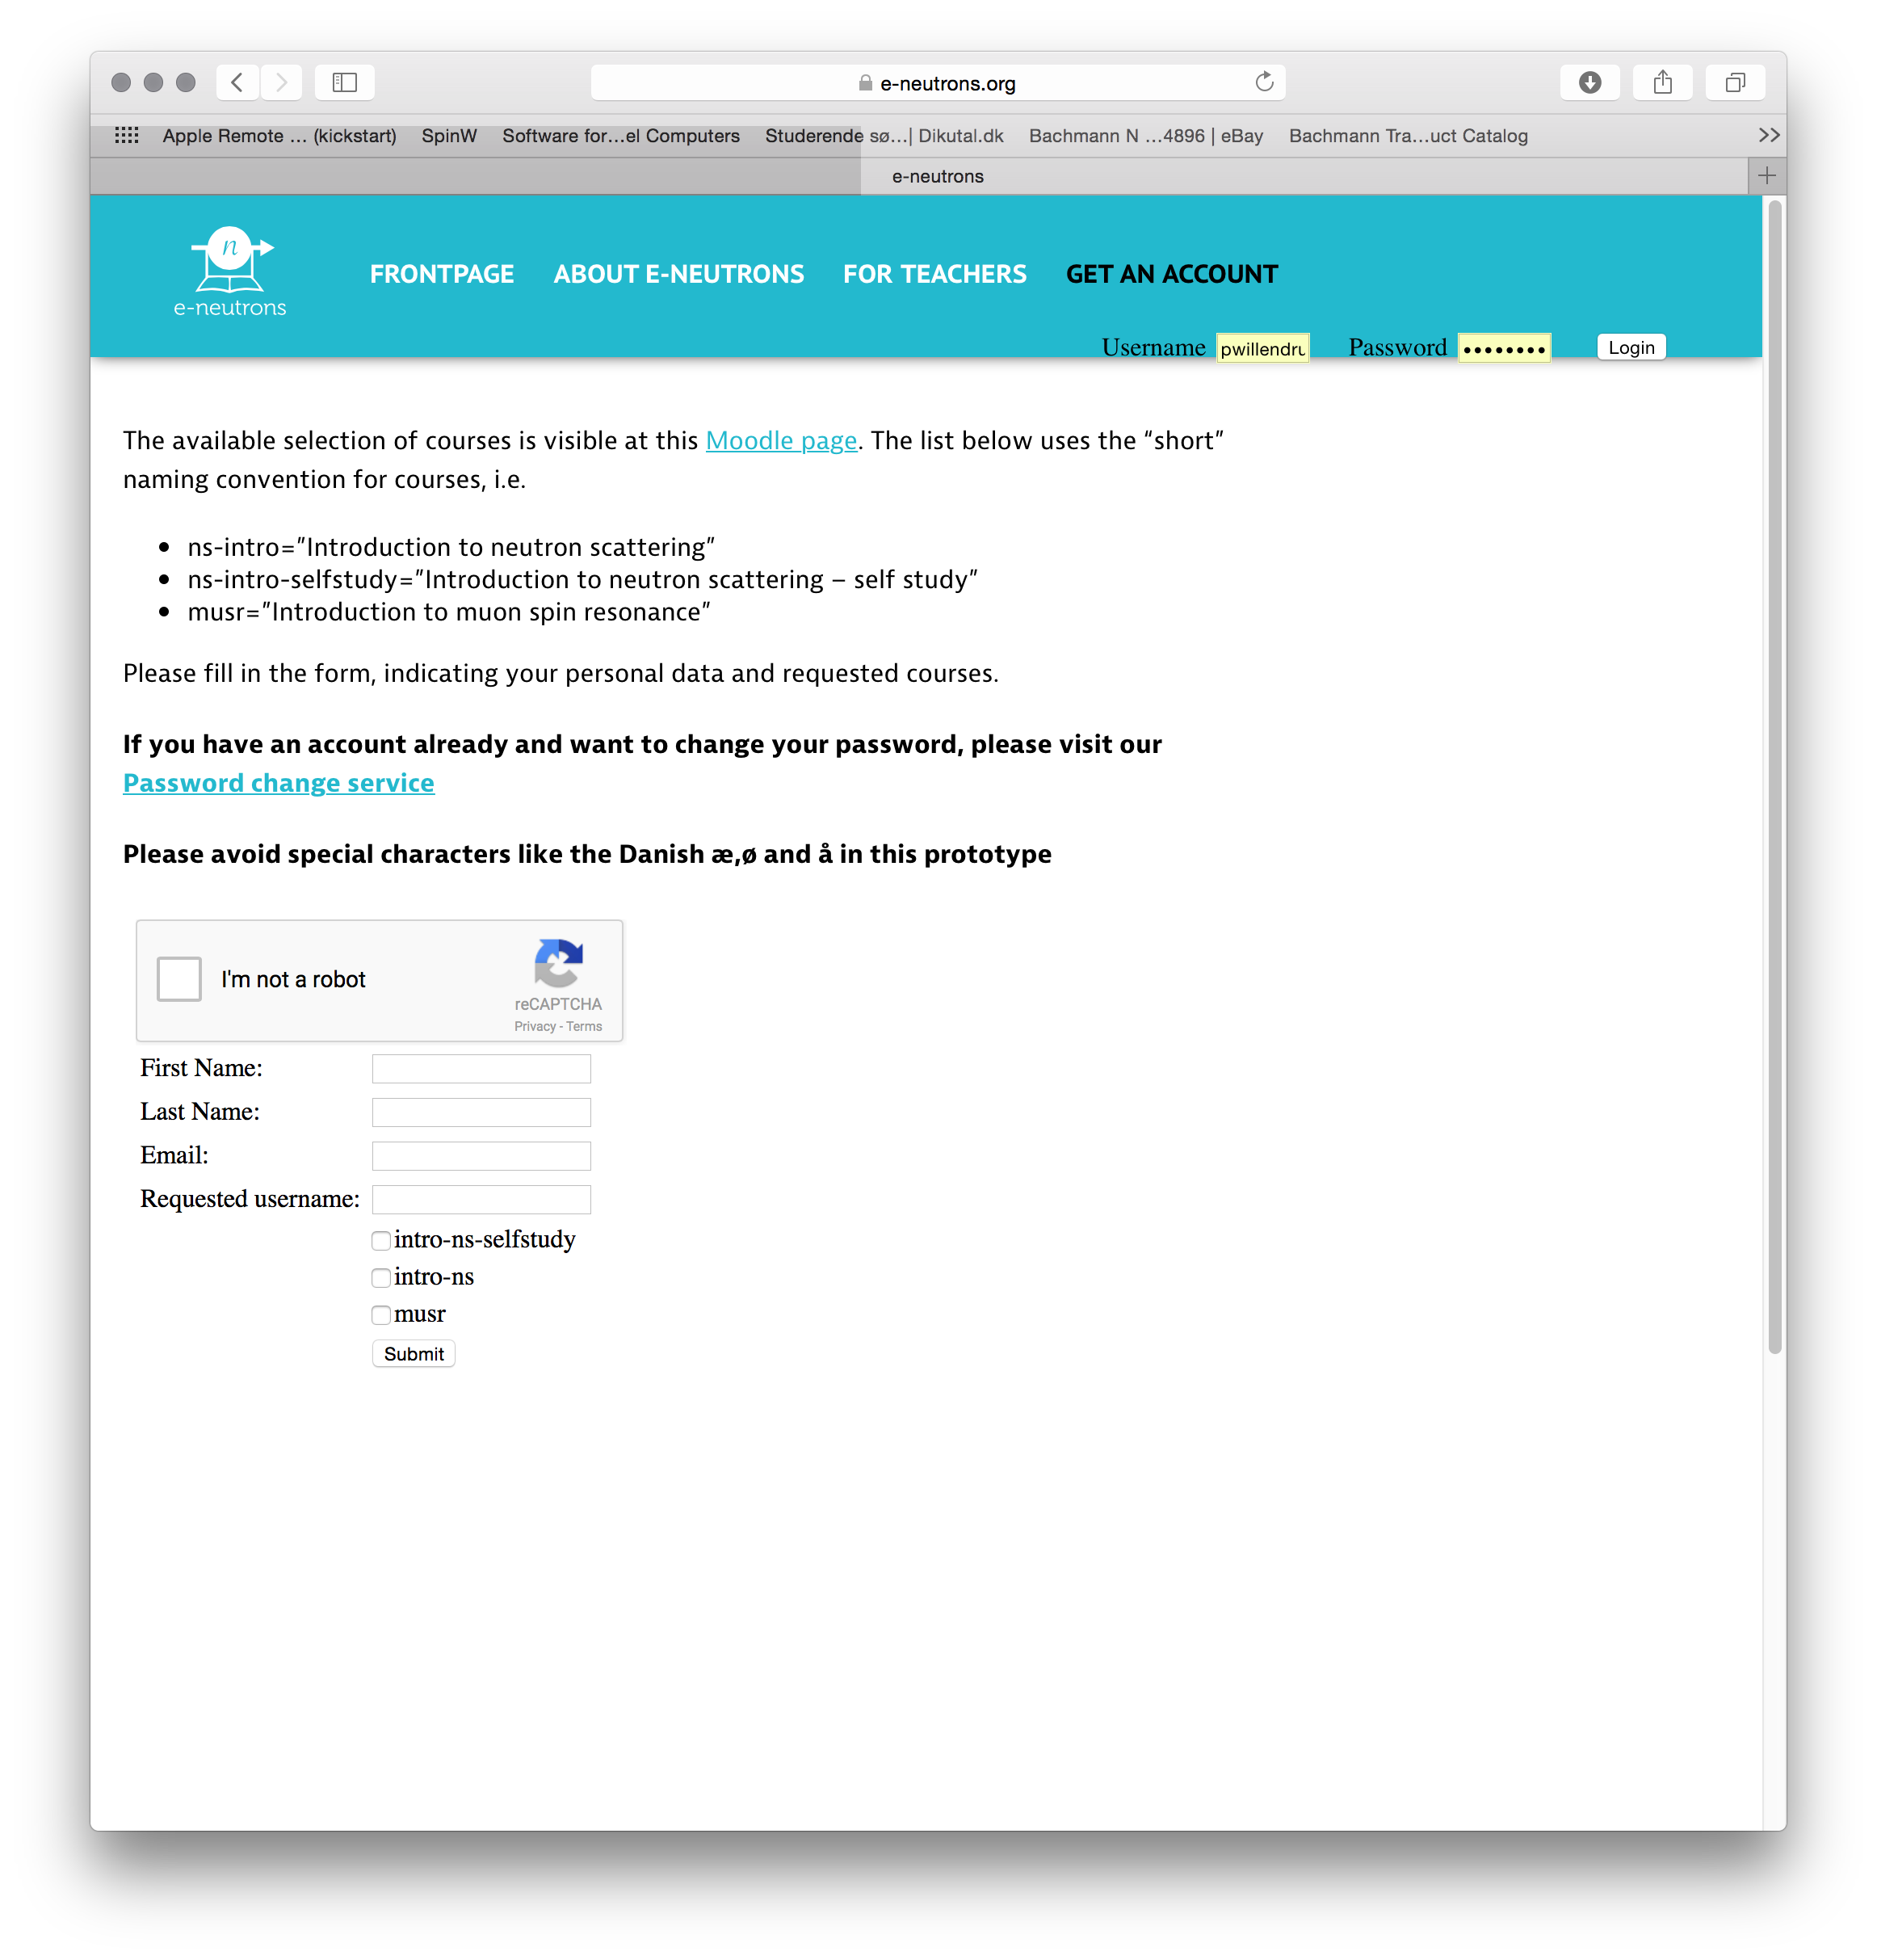
Web interface @ e-neutrons.org

Slide 30
Web interface @ e-neutrons.org
Free subscription!!

